Slide 1
APPLIED DATA SCIENCE CAPSTONE
Hari Hara Sharan

Slide 2
Introduction and background
XYZ is a housing agency which provide their clients with the best locations to rent/buy a house based on their most important necessities
XYZ housing agents thrives on the following motto:
“ Our ultimate goal is to come up with the right address for your dream home.”
Give us your needs and using data science we come up with the perfect location.

Slide 3
Problem
A client has moved from Los Angeles to New York City. Following are his needs for a new place in New York City.
Gym/fitness center
Park
Supermarket
All within a 750 m radius so that he can reach any of these places by foot.
The Client also wishes for a quiet place and not a bustling neighborhood.

Slide 4
Methodology and data used
The following link is used to get the latitude and longitude data of NYC:
https://geo.nyu.edu/catalog/nyu_2451_34572
Preliminary analysis was done to identify the various boroughs of NYC.

Slide 5
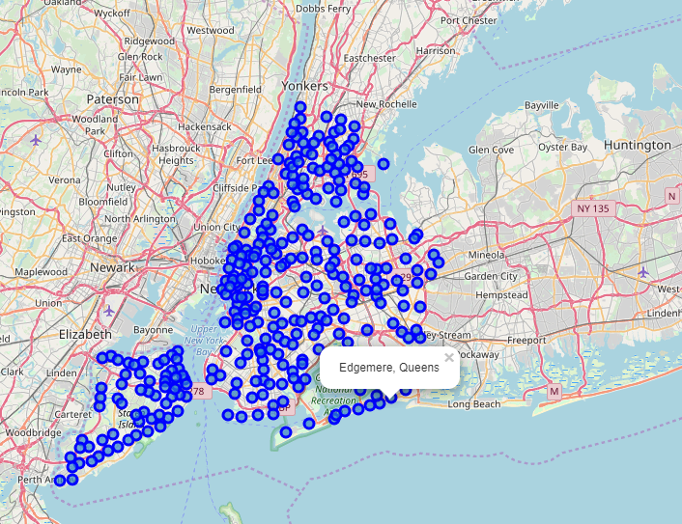
Neighborhoods in New York City. It can be seen that Queens and Staten Island are not directly connected to center.

Slide 6

Tools used
Foursquare API
The API endpoints used are – venues: (search and explore)
k-means clustering – used for clustering neighborhoods with similar venue popularity

Slide 7
Results
Based on the clustering analysis, the identified neighborhoods are as follows:
Bronx – Westchester Square, Mott Haven and Concourse Village
Manhattan – Stuyvesant Town
Brooklyn – New Lots
Adding the criteria of a calm neighborhood, the best recommendation would be Concourse Village in Bronx.

Slide 8
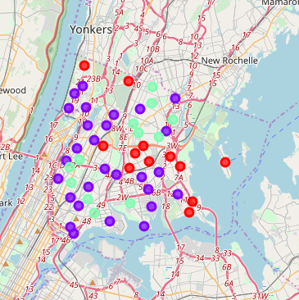
Clustering analysis of Bronx:
Cluster 0: (Red) – Italian Restaurants/Pizza Places
Cluster 1: (Purple) – Gyms/Fitness Centers/Activity centers
Cluster 2: (Green) – Fast food centers/Donut shops

Slide 9
Discussions
Certain limitations of the study include:
1) It does not consider the average rental values of properties.
2) It does not consider the safety of the neighborhoods.
3) The socio-economic data of the client is neglected.

Slide 10
Conclusions
Using foursquare API and k-means clustering, ideal neighborhood locations were identified based on certain specified criteria.
Data Science methodology was used in solving the problem.
Room for improvement to include more parameters but the basic essence remains the same.

